Slide 1

UNIVERSITY INSTITUTE OF ENGINEERING
COMPUTER SCIENCE ENGINEERING
Bachelor of Engineering (Computer Science & Engineering)
Subject Name: Big Data Analytics
Subject Code: 20CST-471
Types of NoSQL databases (Document-oriented, Column-family, Key-value, Graph databases)
Mapped with CO3
Prepared By:
Er. Ankita Sharma
DISCOVER . LEARN . EMPOWER

Slide 2
Types of NoSQL databases (Document-oriented, Column-family, Key-value, Graph databases)
Document-oriented Databases: Document-oriented databases, such as MongoDB and Couch DB, are designed to store, retrieve, and manage data in the form of documents.
These documents, typically in formats like JSON or BSON, can vary in structure within the same database.

Slide 3
This flexibility allows developers to adapt the data model as application requirements evolve. Document-oriented databases are well-suited for content management systems, e-commerce applications, and any scenario where data structures can change over time.
Column-family Databases: Column-family databases, like Apache Cassandra and HBase, organize data into columns rather than rows, providing high scalability and performance. They are particularly effective in handling large volumes of distributed data across multiple nodes.
The architecture allows for efficient read and write operations, making column-family databases suitable for time-series data, sensor data, and other use cases that require quick access to vast amounts of data with low latency

Slide 4
Key-value Stores: Key-value stores, represented by databases like Redis and DynamoDB, are the simplest form of NoSQL databases. They store data as key-value pairs, where each piece of data is associated with a unique key.
These databases offer fast and efficient data retrieval, making them ideal for caching, session storage, and real-time analytics.
Key-value stores excel in scenarios where simple data access patterns and high-speed operations are prioritized.

Slide 5
Graph Databases: Graph databases, exemplified by Neo4j and Amazon Neptune, focus on representing and querying data in terms of graph structures, comprising nodes, edges, and properties.
This model is especially powerful for scenarios involving complex relationships and connections.
Graph databases are commonly used in applications like social networks, fraud detection, and recommendation engines, where understanding and navigating intricate relationships are paramount.

Slide 6
Schema Flexibility: Document-oriented databases allow for dynamic schema, meaning each document in the collection can have a different structure.
This flexibility is advantageous in scenarios where data evolves or varies between entries.
Rich Query Support: These databases often provide powerful querying capabilities, enabling complex queries on the document content.
This makes them suitable for applications that require diverse and ad-hoc querying.

Slide 7
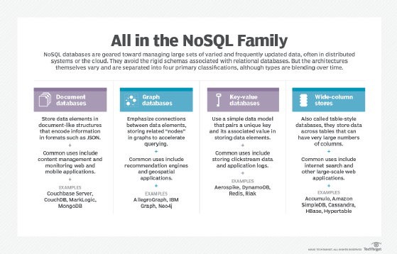

Slide 8
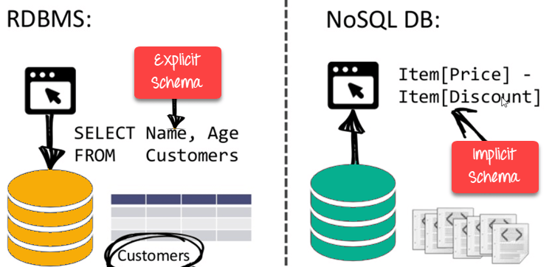

Slide 9
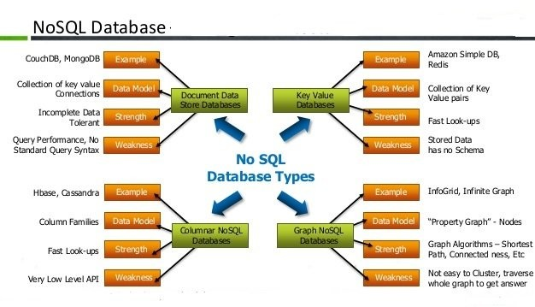

Slide 10
Thankyou

